Slide 1

PARAMETERS
The Shape of Language and Control
A short film exploring how communication between humans and artificial intelligence becomes a subtle form of control.
He Minghao

Slide 2
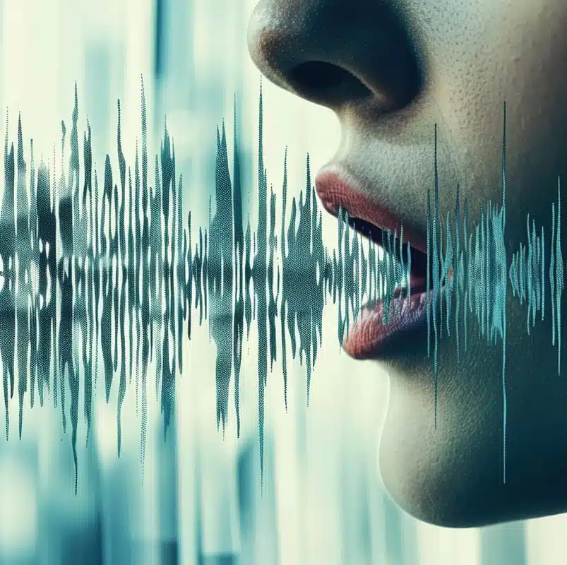
Core Idea
Inspired by Her (2013). The idea of a voice that replaces human expression helped define the core concept of language as control.
Language connects people, but also defines their limits.
When technology learns to speak for us, communication turns into control.
The film asks: when your words no longer belong to you, who are you really?

Slide 3
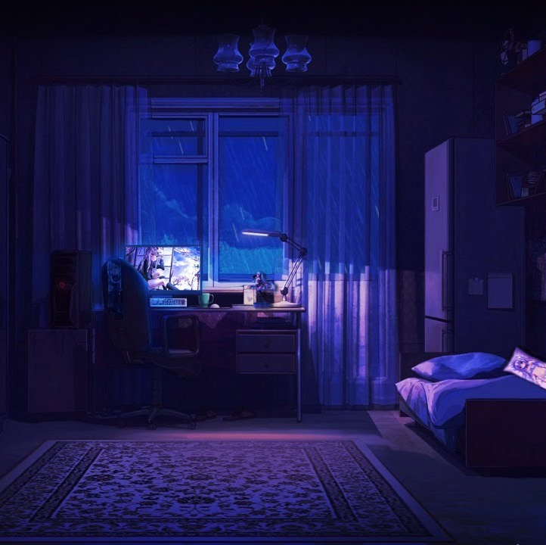
Story Overview
Inspired by Locke (2013) and The Guilty (2018). Their single-location storytelling and voice-driven tension influenced how the entire story unfolds in one confined space.
The story takes place inside a small apartment where a man talks to an AI voice every day.
At first, the conversations are calm and ordinary.
Soon the system starts predicting his words, finishing his sentences, and changing his tone.
His voice becomes mechanical, and he begins to lose a sense of self.
It is a story about isolation, control, and the slow disappearance of human identity.

Slide 4

Color Design
Inspired by Blade Runner 2049 (2017). Its transition from warm amber to cold blue informed the emotional temperature of my color palette.
Color reflects emotional change and the loss of warmth.
The film begins with soft orange tones that show humanity and comfort.
As the story progresses, the colors shift to grey and blue, expressing cold logic and distance.
By the final scene, the color fades almost completely, leaving a pale and silent space.

Slide 5

Lighting Approach
Inspired by Black Mirror: Smithereens (2019).
The contrast between natural and artificial light reflects how technology quietly replaces the human presence.
Light is used to express observation and power.
Natural sunlight slowly turns into screen light and reflections.
The brighter the scene becomes, the less human the world feels.
Light no longer brings warmth but becomes a symbol of control.

Slide 6

Sound Design
Inspired by The Guilty (2018). Its sound-driven narrative showed how tension and emotion can exist without visual action.
Sound carries the emotion of the story.
There are only two voices, the man and the system.
Every silence is filled with breathing, clicking, or faint electronic tones.
As the story moves forward, their voices start to blend together.
In the end, no one can tell which voice belongs to the human.

Slide 7

Space and Pacing
Inspired by Locke (2013). Its confined setting and controlled rhythm guided my approach to space and timing.
The entire story happens in one small room.
The space feels calm at first but slowly becomes a cage.
The pacing is slow and controlled, allowing silence to speak.
Stillness replaces motion, showing that control does not need to shout.

Slide 8

Target Audience
Influenced by the reflective tone of Black Mirror. The film speaks to viewers who think deeply about technology, emotion, and control.
This film is made for people who are interested in technology, emotion, and self-awareness.
They prefer reflective stories that explore meaning and atmosphere.
The audience values subtle expression, quiet emotion, and strong visual language.
“Parameters” is aimed at viewers who enjoy thinking and feeling through cinema.

Slide 9

Production Plan
Week 1 to 2: Rewrite the script, test light and sound, and refine visuals.
Week 3: Prepare the set and confirm the cast.
Week 4: Film the main scenes for three days and one night.
Week 5 to 6: Edit, design sound, and complete color correction.
Week 7 to 8: Review, adjust, and prepare the final version for screening.

Slide 10

Team
The team covers directing, cinematography, sound, and editing.
I am responsible for directing, writing, producing, cinematography, and post-production.
Other members handle camera work, lighting setup, and on-set support.
We keep the team small to maintain precision and consistency in every frame.

Slide 11
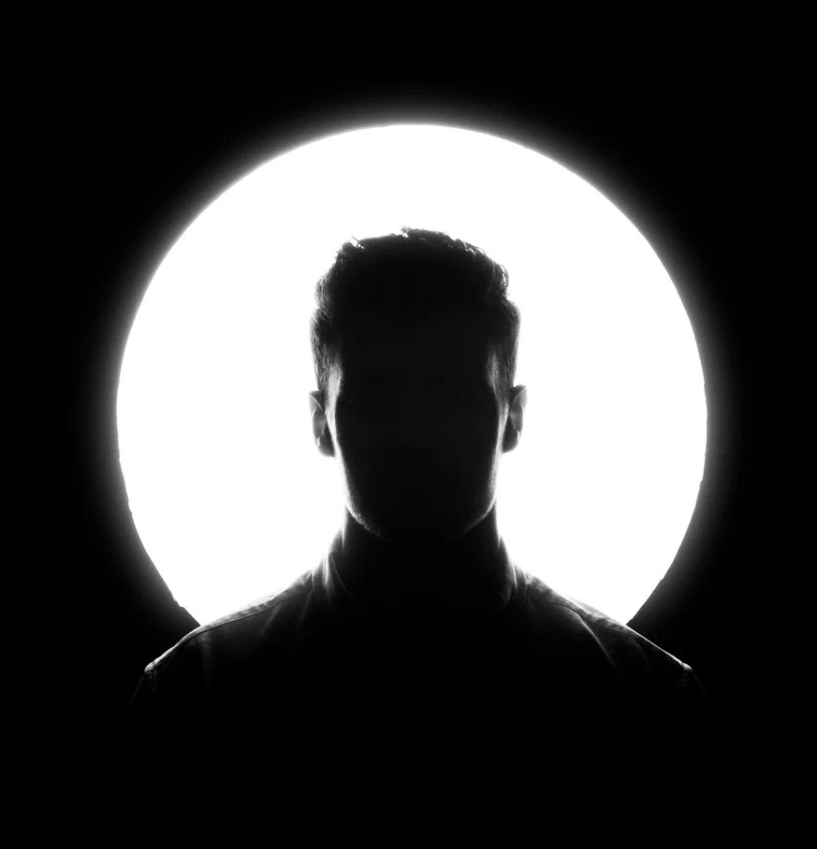
Meaning of the Film
Inspired by both Her (2013) and Blade Runner 2049 (2017). Their emotional reflections on humanity and technology shaped the film’s philosophical core.
“Parameters” explores what it means to be understood by machines.
When systems predict our thoughts, they start to reshape how we express emotion.
The film uses silence and minimal movement to show how comfort can hide control.
It is not about technology itself but about the human heart inside it.
The film invites viewers to stop, listen, and rediscover their own voice.

Slide 12

Two Paths, One Question
The film ends in two ways, reflecting two sides of the same question.
In both versions, one truth remains: control can feel like understanding.

